Slide 1




GLORIOUS
TASKHELP
Empowering Success One Task at a Time
Presented by
Suraj Hipparge, Timea Kadas, Priyal Panda

Slide 2

OVERVIEW
GloriousTaskHelp is an innovative application designed to connect customers with service providers for a wide range of tasks, including chores, consulting, maintenance, beauty services, and more
Gloria, our AI assistant, helps match customers with ideal, reliable helpers based on their specific needs, saving time and effort for busy individuals
User-friendly app with categorized service options
Intelligent filtering based on cost, location, ratings, and more
Secure payment gateway and rating system for service providers

Slide 3

DESCRIPTION
Here is a glimpse of our prototype:
Diverse Service Categories
Errands: package returns, laundry, dry cleaning pick up, child pick up, etc.
Beauty & Style: hairstyling, makeup, nails, and personalized looks
Consulting: financial, legal, educational, cooking, and lifestyle advice
Caretaking: assistance with child care, pet care, plant care, and senior care
Recurring Tasks: schedule regular help for ongoing needs such as cleaning, lawn mowing, snow blowing, etc.
User-friendly interface
Easy navigation for all users
Helps users find the perfect match for their tasks efficiently
Key features
Task matching, service booking, and secure payment options

Slide 4

DEMONSTRATION
https://marvelapp.com/prototype/cd626jj/screen/96142602

Slide 5



COMPETITOR AND INDUSTRY ANALYSIS
Broader Range of Services
Advanced AI Matching & Affordable Options
Barriers to Entry
GloriousTaskHelp offers a broader range of services compared to TaskRabbit and Angi
TaskRabbit mostly offers solutions for assembling furniture or small home repairs
Similarly, Angi focuses on connecting customers with home repair professionals
We utilize advanced AI matching capabilities to connect customers with the right service providers
GloriousTaskHelp provides affordable options that cater to diverse customer needs
Investment required for marketing and building client relationships
Seamless transactional processes are crucial to overcome hesitation
Promoting the integration of our services into daily routines
Adhering to safety regulations for customers and workforce

Slide 6
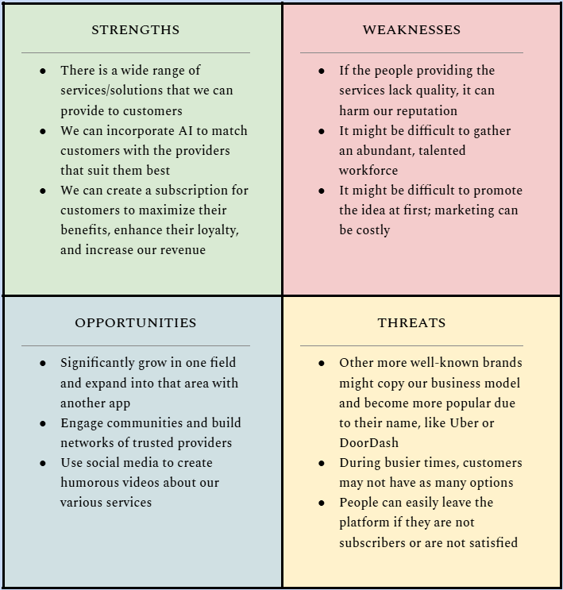

SWOT ANALYSIS

Slide 7

MARKETING STRATEGY
We aim to reach a range of individuals from ages 18 to 65 who prioritize convenience and have the technical ability to use an app.
Key customer segments
Busy professionals: demanding work schedules
College students: may lack the time or skills for certain tasks like cooking
Busy parents: need assistance with childcare and household tasks
Elders: help with daily activities due to age or physical limitations
Our marketing strategy
Targeted campaigns: utilizing social media platforms like TikTok and Instagram to reach busy individuals through short videos
Referral programs: encouraging users to invite friends for discounts and promotions
Engaging content that resonates with our audience
Personalized ads highlighting the app's ability to solve specific customer problems

Slide 8
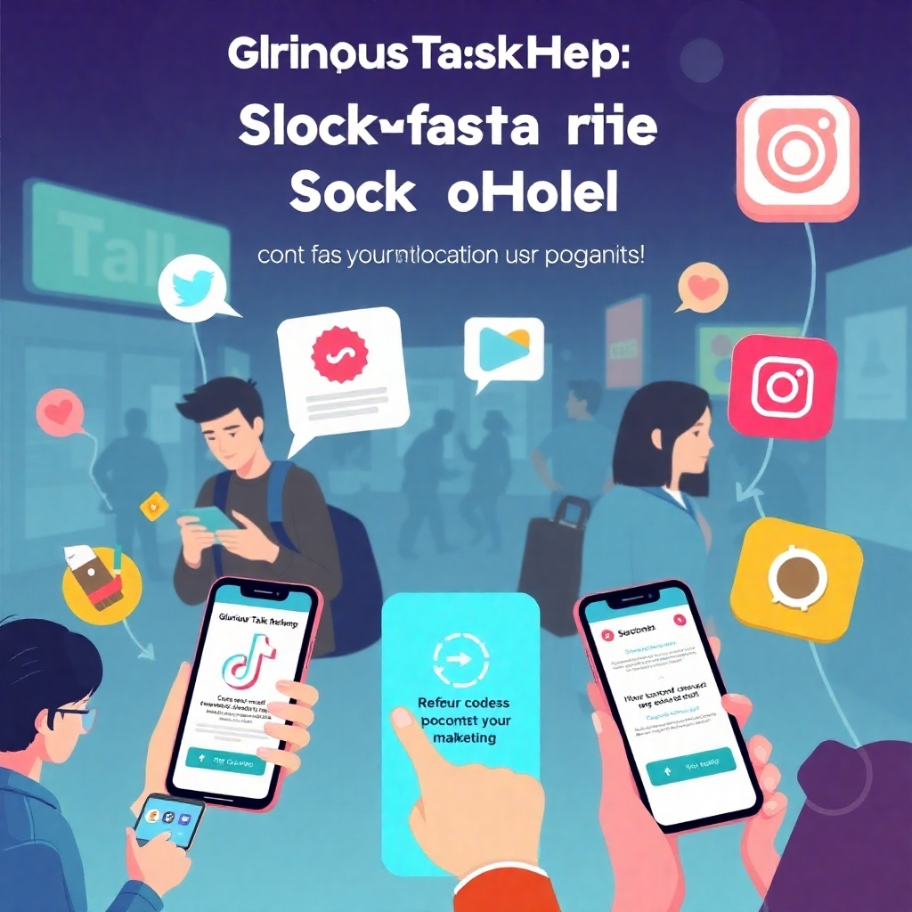
MARKETING STRATEGY
Customer Retention
Loyalty program with tiered rewards for frequent users
Engaging push notifications based on user behavior
Exceptional customer support through various channels
Pricing
Flexible model: GloriousTaskHelp uses a pricing model designed to adapt to diverse customer needs and preferences
Service fee: a 5% fee is applied to each completed service
Rates set by helpers: workers set their own prices for services, guided by company recommendations based on factors like demand and real-time analysis
Tiered Subscription Plans
Offer customers options for priority booking, discounts on frequent purchases, and access to expedited customer support
Caters to budget-conscious users while also providing options for those willing to pay for premium services and support

Slide 9

OPERATIONS STRATEGY
Our operational framework
In-house app development: ensuring quality and control over our product
Cloud computing: this ensures optimal performance and scalability of the app
Payment APIs and a unique verification system are integrated to minimize costs and streamline customer experience
Supply chain management
Ensuring Uptime and Security: preventing downtime of critical technology components, like cloud storage and payment gateways, is crucial for business continuity
Adequate cybersecurity measures are essential for maintaining user trust and protecting sensitive data
Customer service support
Providing 24/7 assistance to users through in-app messaging and a live chat feature

Slide 10
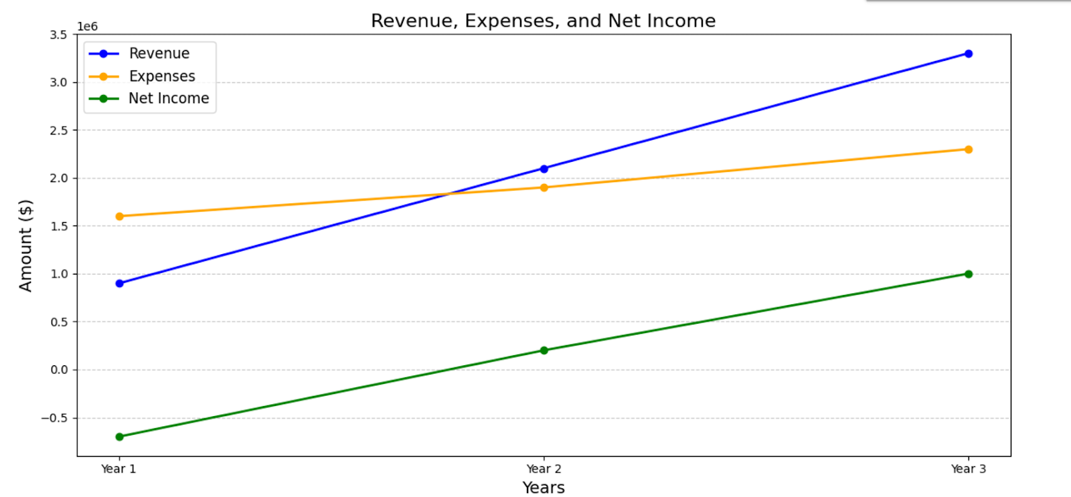
FORECASTS AND FINANCIALS
Revenue Model
5% service fee on each completed task
Subscription fees from tiered plans offering premium features
Projected Growth
Expanding the user base from 15,000 active users in the first year to 50,000 users in the third year
Geographic expansion: expand operations from 3 major cities in the first year to 15 urban regions by the third year
Revenue expected to grow from $700,000 in first year to $3 million in third year

Slide 11
STAGE OF DEVELOPMENT AND IMPLEMENTATION PLAN
Currently, we are in the pre-launch phase
Beta testing: gathering feedback to refine our app
Implementation plan: launching in key urban areas, with a focus on scalability and user experience
First Quarter
Second Quarter
Third quarter
Fourth quarter
1. Finalize testing of the app and advertisements for TikTok, and ensure continuous cooperation with third parties involved
2. Focus on onboarding the initial pool of task providers
3. Complete a release of the application in a test market and gather feedback on usability, experience, and fulfillment of tasks
1. Scale the recruitment of workers to additional cities
2. Refine the design of the application and optimize algorithms
3. Launch the full advertising campaign, including digital marketing on TikTok, Instagram, and Google
1. Expand availability to 3 key urban areas that have strong potential based on market research
2. Monitor the performance of our app, and track the retention of customers and workers
3. Expand customer support channels and conduct internal stress tests for operations
1. Adjust advertisements once the brand is established
2. Establish relationships with churches, universities, or eldercare facilities where people are expected to search for assistance
3. Prepare for seasonal adjustments to handle surges

Slide 12
FUNDING
Seeking $3.7 million in funding over the next three years.
Funds to be allocated towards platform development, marketing, operational expenses, and regional expansion.
Over a five-year period, investors can expect a return of three times their initial investment.
This funding will be used for:
■ Development and Marketing: $1.5 million in the first year to optimize app, launch marketing campaigns, and cover operational expenses
■ Scaling Operations and Expanding Reach: $1.2 million in the second year to increase server capacity, expand marketing efforts, and enhance data security
■ Technological Advancements and Retention Efforts: $1 million in the third year to stay ahead of technological trends, further expand services, and invest in customer and helper retention initiatives

Slide 13


THANK YOU!
In summary, GloriousTaskHelp is poised to revolutionize the way individuals connect with service providers.
With a strong team, innovative technology, and a clear market strategy, we invite you to join us in this exciting venture and be part of a transformative service platform!

